Slide 1
Chapter 8 Multidimensional Arrays

Slide 2
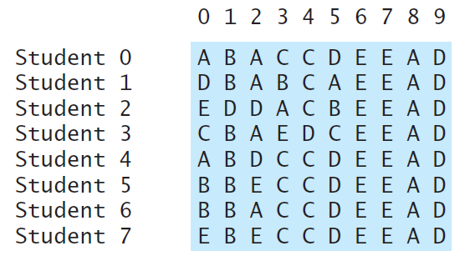
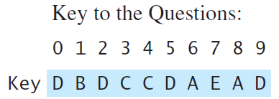
Problem: Grading Multiple-Choice Test
Students’ answer
Objective: write a program that grades multiple-choice test.
PassTwoDimensionalArray
Run

Slide 3
GradeExam.java
Page 295 Listing 8.2

Slide 4
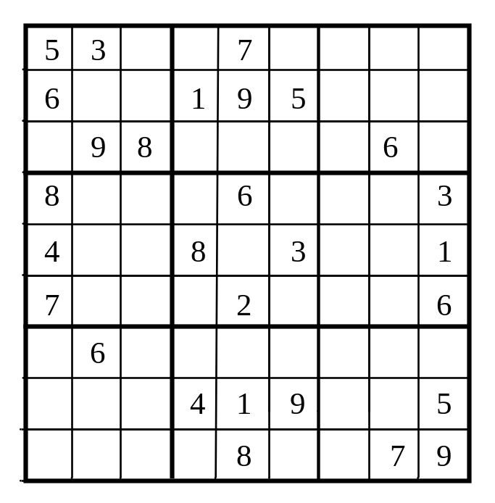
What is Sudoku?
http://www.cs.armstrong.edu/liang/animation/web/Sudoku.html

Slide 5
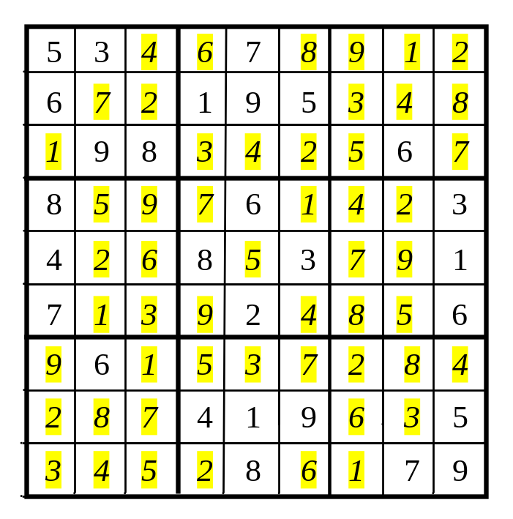
Every row contains the numbers 1 to 9

Slide 6
Every column contains the numbers 1 to 9
5 3
4
6
7
8
9
1
2
6
7
2
1 9 5
3
4
8
1
9 8
3
4
2
5
6
7
8
5
9
7
6
1
4
2
3
4
2
6
8
5
3
7
9
1
7
1
3
9
2
4
8
5
6
9
6
1
5
3
7
2
8
4
2
8
7
4 1 9
6
3
5
3
4
5
2
8
6
1
7 9

Slide 7
Every 3×3 box contains the numbers 1 to 9
5 3
4
6
7
8
9
1
2
6
7
2
1 9 5
3
4
8
1
9 8
3
4
2
5
6
7
8
5
9
7
6
1
4
2
3
4
2
6
8
5
3
7
9
1
7
1
3
9
2
4
8
5
6
9
6
1
5
3
7
2
8
4
2
8
7
4 1 9
6
3
5
3
4
5
2
8
6
1
7 9

Slide 8
Checking Whether a Solution Is Correct
PassTwoDimensionalArray
Run

Slide 9
CheckSudokuSolution.java
Pages 299-300 Listing 8.4

